Slide 1
EE207: MOSFETs
Saurabh Lodha

Slide 4
Bulk Charge Theory
Accounts for varying depletion charge along the channel --> more accurate charge balance

Slide 5
Square law vs bulk charge
Square law overestimates the current
More accurate theories also account for channel charge below Vt
Charge sheet
Exact charge

Slide 6
Small Signal AC Equivalent
Low and high frequency models

Slide 7
g_{m} and g_{d}
Max frequency of operation depends on mobility and channel length

Slide 8
Mobility, V_{t} and Cox
Output conductance and C-V curves help determine mobility, V_{t} and C_{ox}

Slide 9
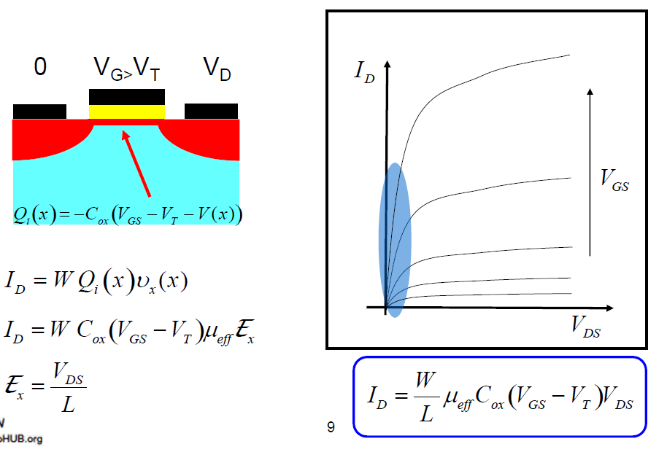
MOSFET I-V: Low V_{DS}

Slide 10
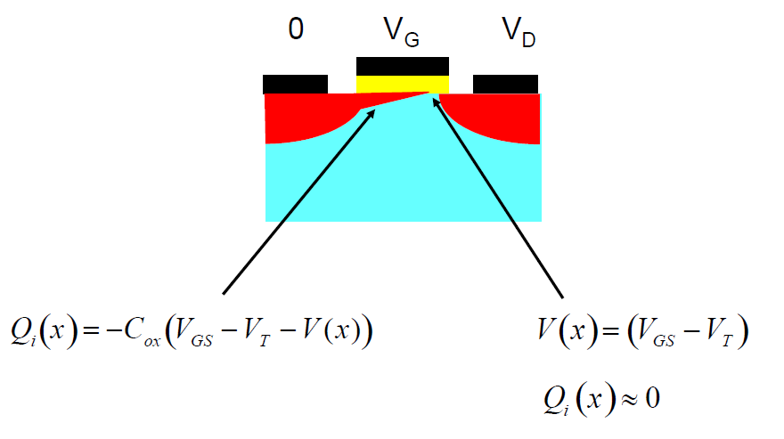
MOSFET I-V: Pinch-off at high V_{DS}

Slide 11
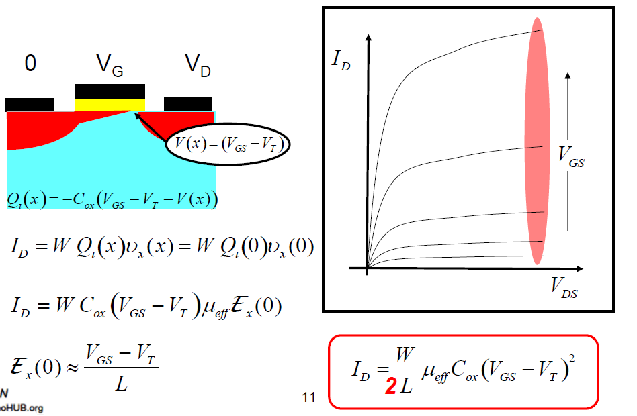
MOSFET I-V: High V_{DS}

Slide 12
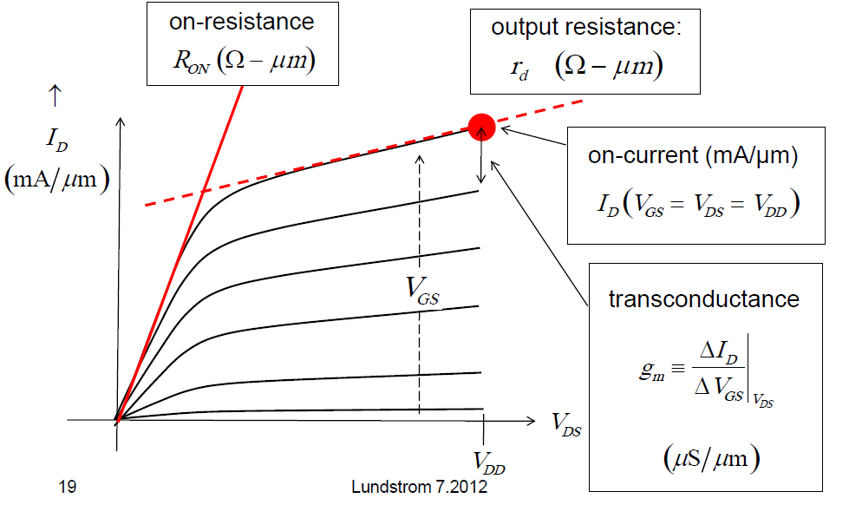
MOSFET Device Metrics: Output Characteristics

Slide 13
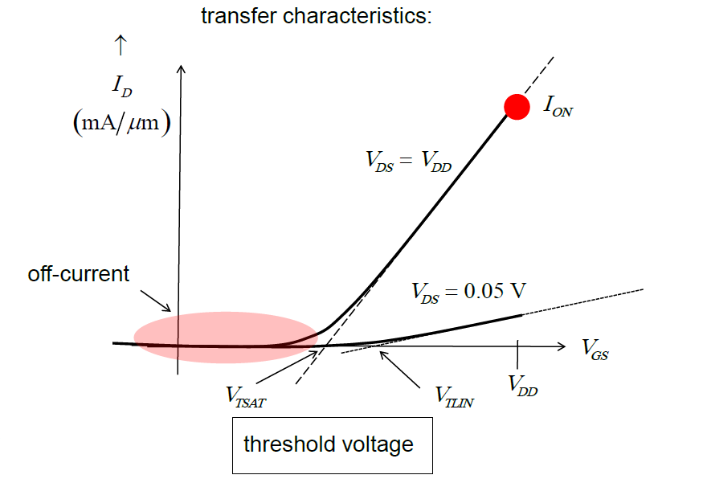
MOSFET Device Metrics: Transfer Characteristics

Slide 14
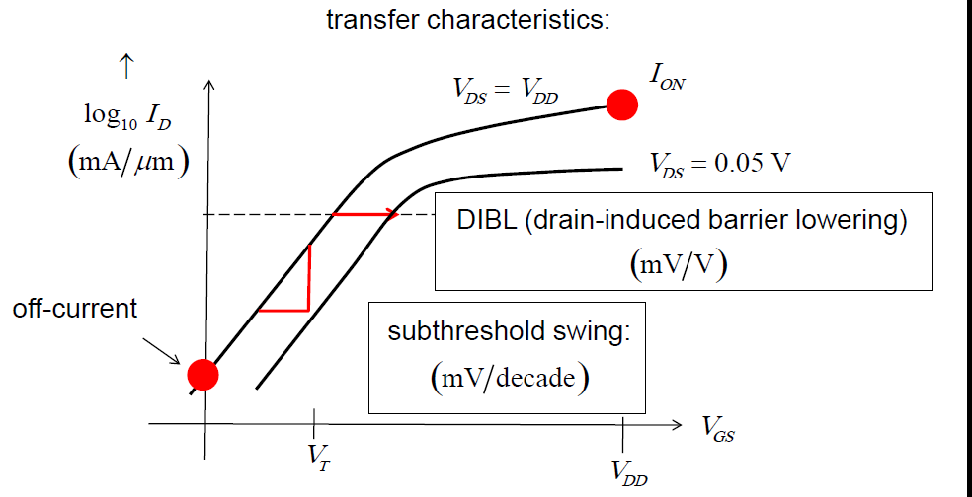
MOSFET Device Metrics: Transfer Characteristics

Slide 15
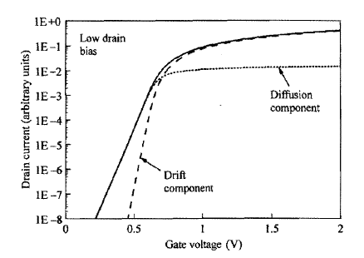
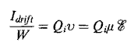
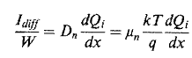
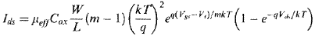
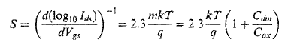
MOSFET Device Parameters
Above V_{t}
Below V_{t}
Drift current (above V_{t})
Diffusion current (sub-threshold, sub V_{t})

Slide 16
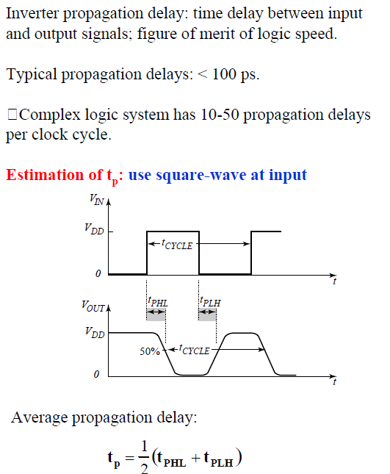
CMOS Inverter: Speed (Propagation Delay)
More the delay less is the speed

Slide 17
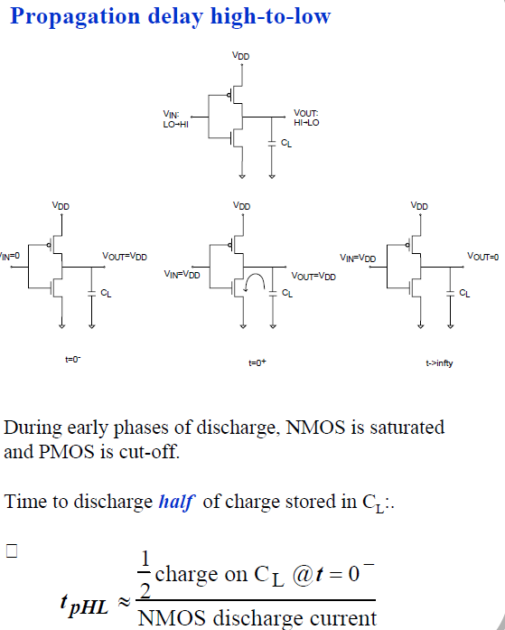
CMOS Inverter: Propagation Delay → High to Low
Discharging of Load Capacitance

Slide 18
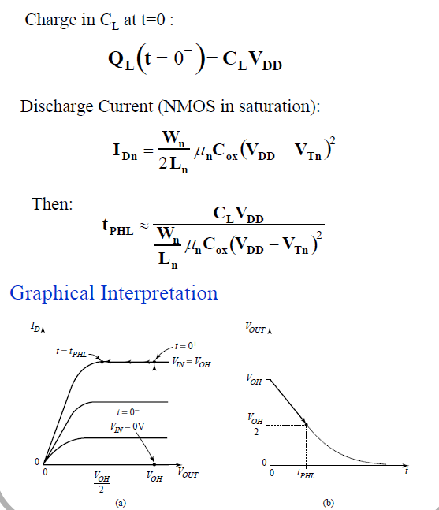
CMOS Inverter: Propagation Delay → High to Low
High V_{DD} reduces t_{PHL}
Higher current (I) reduces t_{pHL}

Slide 19
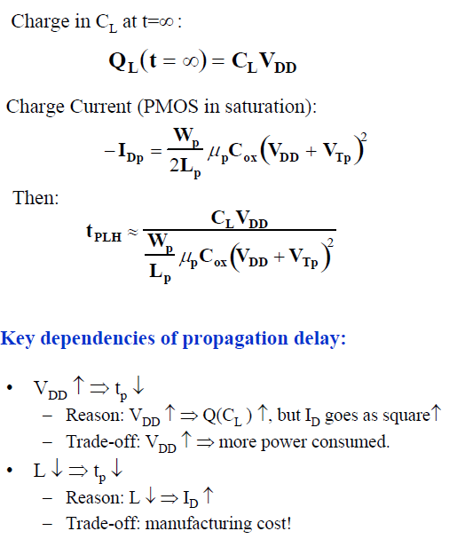
CMOS Inverter: Propagation Delay → Low to High
Scaling L can help reduce delay
New CMOS technologies
Increasing V_{DD} → higher power!

Slide 20
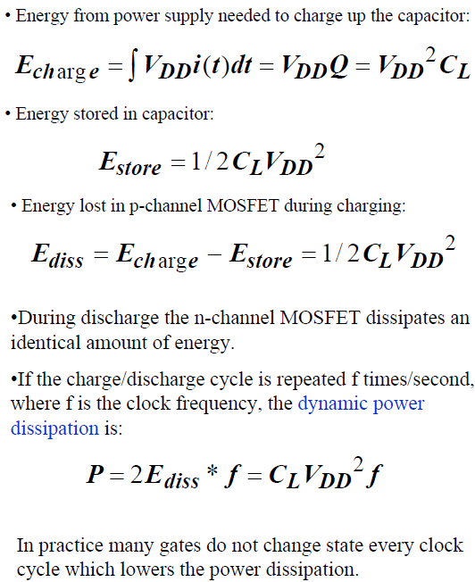
Power Dissipation
Note
V_{DD} dependence
f-dependence
Reduction of C_{L} is a win-win for both speed and power

Slide 21
Back up

Slide 22
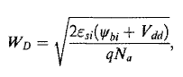
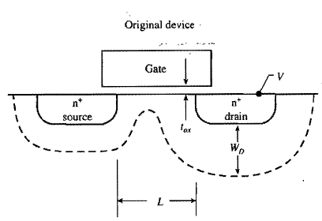
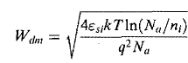
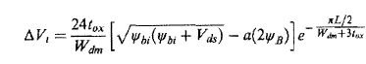
MOSFET Device Parameters
Depletion widths (determines short channel effects)
V_{t} roll off
DIBL → Drain induced barrier lowering

Slide 23
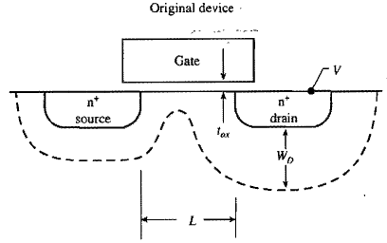
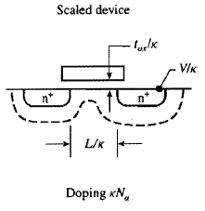
Constant field scaling (Dennard)
Device dimensions (horizontal and vertical) and voltages are scaled by the same factor k (>1) so that electric field stays unchanged

Slide 24
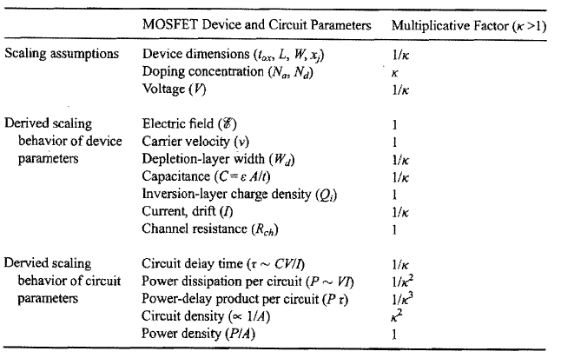
Constant Field Scaling
Keep Poisson’s eqn invariant
Q_{i}=C_{ox}(V_{gs}-V_{t})
k
Subthreshold current does not scale down
Circuit speeds up by 1/k
Power density constant! → active power per chip area is constant

Slide 25
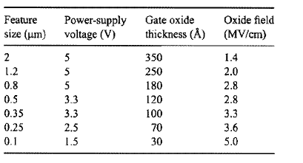
Constant field scaling
Requires aggressive scaling of voltage supply
Subthreshold current does not scale down
Electric field has been increasing

Slide 26
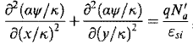
Generalized Scaling
E →aE
Dimensions → 1/k
Voltage → a/k
Doping → ak (to maintain invariance of Poisson’s equation)
Special cases
Constant field → a=1
Constant voltage → a=k

Slide 27
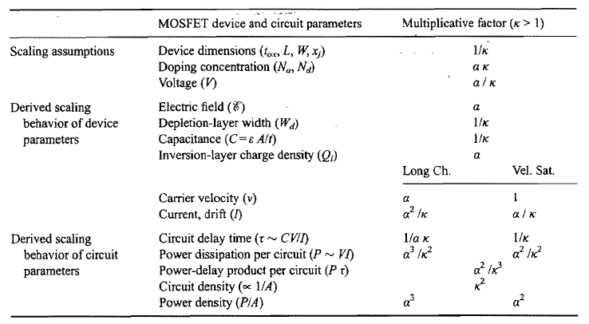
Generalized Scaling
Q_{i}=C_{ox}(V_{gs}-V_{t})
Power density and power delay product go up!
Sub-threshold current goes up by a factor of a

Slide 28
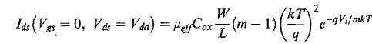
Primary non-scaling factors
kT/q does not change
Subthreshold slope nonscaling
V_{t} cannot be scaled down like other parameters
V_{t} scaling leads to off-current increase
Even for constant V_{t}, I_{off} increases due to C_{ox} increase
Limits V_{dd} scaling

Slide 29
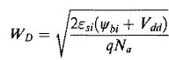
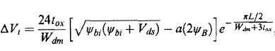
Primary non-scaling factors
E_{g} (bandgap) of Si does not change
Built-in potential and max surface potential do not scale significantly with device scaling
Depletion widths do not scale the way other dimensions do
Short channel effects are worse and requires a larger increase in channel doping

Slide 30
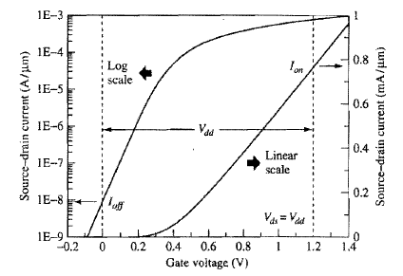
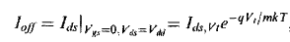
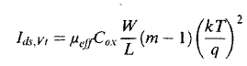
Standby power: lower bound for Vt
Standby power=V_{dd}I_{off}
For <1 W power dissipation in a 10⁸ transistor-chip at V_{dd}=1 V I_{off}<10 nA
Smaller V_{t} → exponential increase in I_{off}

Slide 31
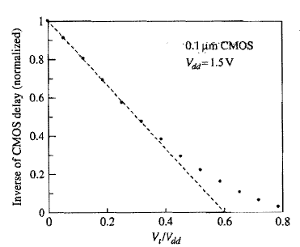
Delay: Upper bound for V_{t}
For high performance ckts V_{t}/V_{dd}<0.25
Increasing V_{t} lowers I_{on} and hence performance (increases delay)

Slide 32
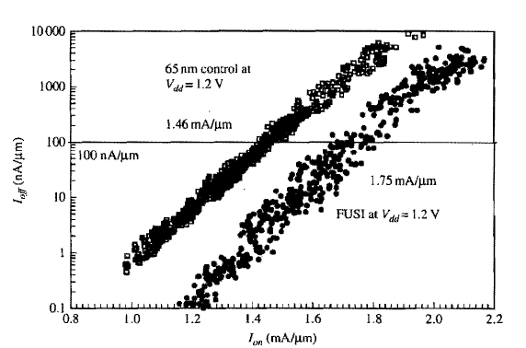
I_{on}-I_{off} distributions
Since V_{t} adjustment trades off I_{off} and I_{on} you need other ways to improve one without trading off the other
At fixed I_{off}, I_{on} improvement is seen

Slide 33
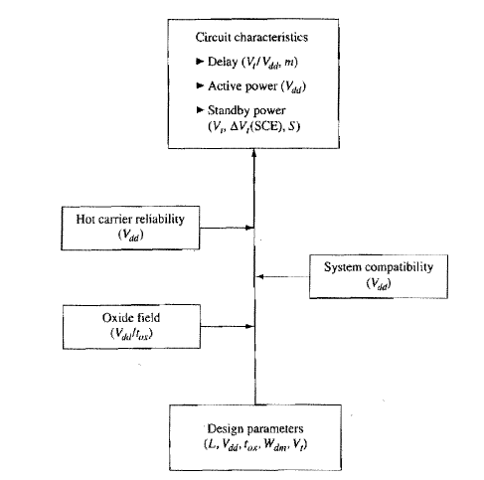
General CMOS Design Considerations

Slide 34
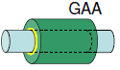
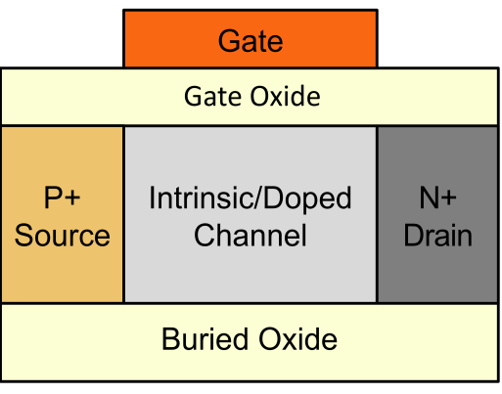
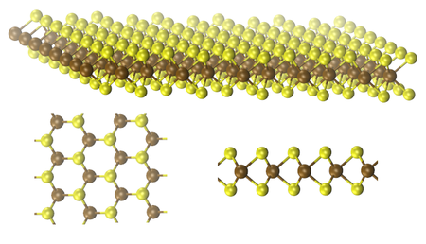
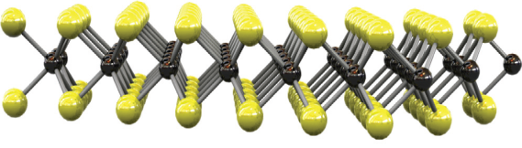
What’s next for Moore’s law?
LG
Improved Electrostatics/Sub-threshold Slope
Drain
Gate
I_{d}=μC_{ox}/L_{eff} (V_{g}-V_{t})^{α}
Source
Lower L_{eff} at same V_{t}, or lower V_{t} at same L_{eff}
Hsi
Scaled FinFETs
GAA FETs
Tunnel FETs
Ultra thin (2D) materials: MoS₂, WSe₂
Wsi
P-I-N TFET
MoS₂
Source
Drain
SiO₂
0.7 nm
Back Gate

Slide 35
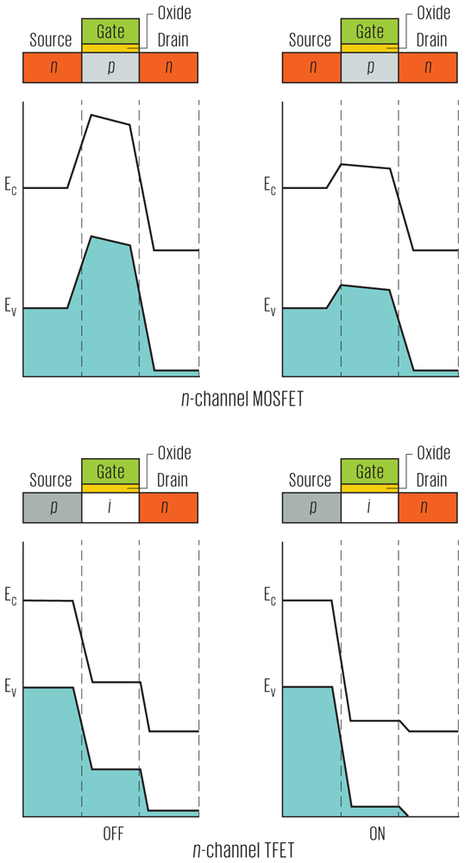
Tunnel FET
Tunneling beats the kT/q thermal limit for transistor switching
http://spectrum.ieee.org/semiconductors/devices/the-tunneling-transistor

Slide 36
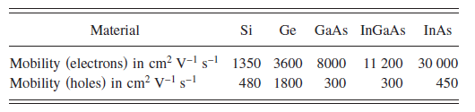
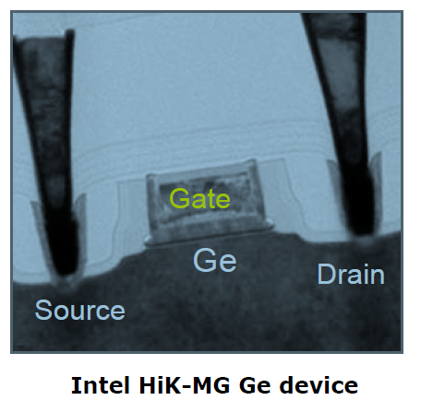
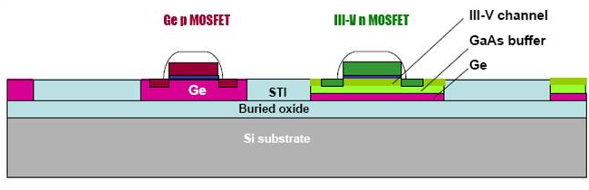
What’s next for Moore’s law?
High Mobility/Injection Velocity
I_{d}=μC_{ox}/L_{eff} (V_{g}-V_{t})^{α}
Mobility enhancement using alternate channel materials, strain, wafer orientation
Lubow et al., APL 96 122105 (2010)
Ge is a single material CMOS solution
Integral part of Si foundries
Intel Developer Forum, Sept. 2011

Slide 37
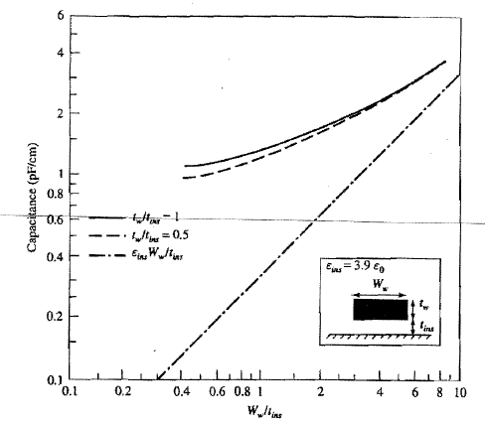
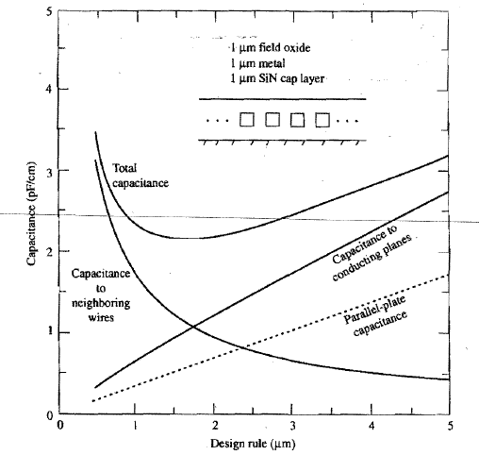
Interconnect capacitance
C_{min}~2πϵ_{ins}
Fringing field capacitance dominates for scaled W_{w}, scaling t_{ins} does not help
The total capacitance hits a min of 2 pF/cm when metal line and space dimensions are comparable to insulator and wire thickness → wire-to-wire capacitance dominates beyond this

Slide 38
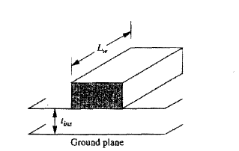
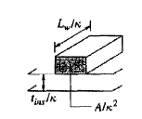
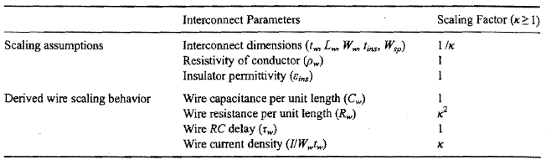
Interconnect Scaling
Scale all dimensions by the same device scaling factor → k
Current density increase can cause reliability issues such as electromigration

Slide 39
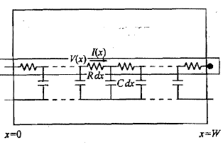
Interconnect RC delay model
You can show that the RC delay for this circuit is 0.5RCW² where R and C are per unit length and W is the length

Slide 40
Interconnect RC Delay
For Aluminum and SiO₂
Local interconnect delay does not scale with dimensional scaling
Need new materials (Cu, low-k dielectric) for delay scaling

Slide 41
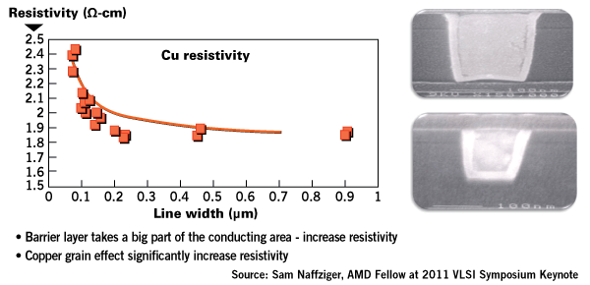
Cu resistivity vs linewidth
New solutions needed for scaled technologies

Slide 42


Global interconnect RC delay
Chip area increase with technology to accommodate more circuits implies L of global interconnects increases with tech scaling
Even if chip size does not increase, RC delay goes up by k² → if cross sectional area is scaled
Global interconnect delays are now limiting CMOS performance

Slide 43




Solutions?
Intelligent circuit design
Avoid global interconnects for critical paths
Repeaters → quadratic to linear dependence
Conventional strategy:
Scale local wiring along with device dimensions
Unscaled or scaled up wiring for global wiring on top
Chip-to-chip → optical, 3D integration

